Slide 1
Introduction to Spark ML
Kamil Owczarek
https://github.com/Saevel/sparkml-workshop

Slide 2
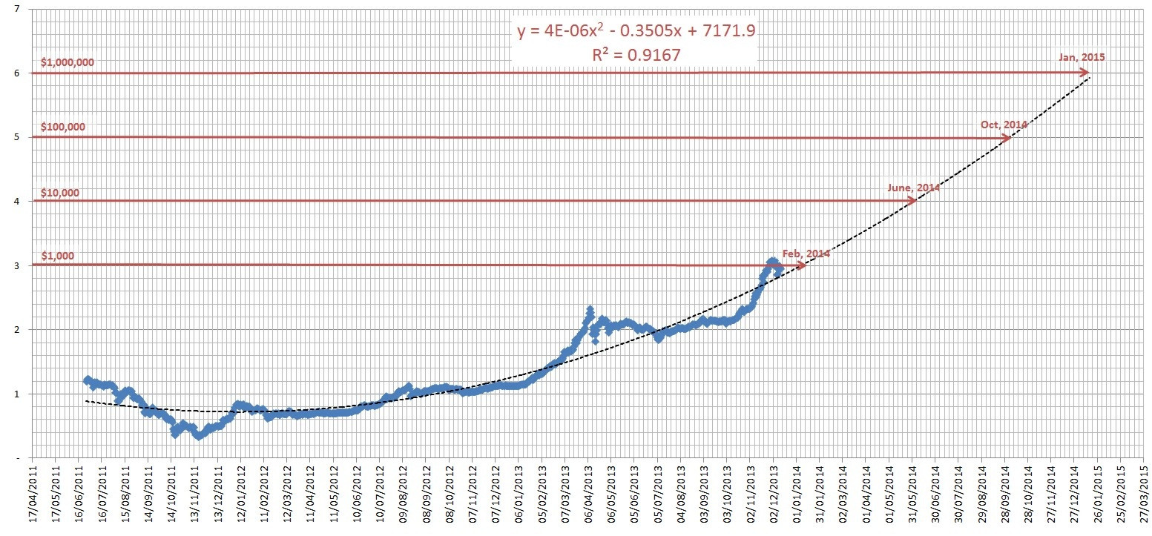
General Concepts: Machine Learning
Assuming there is a non-random relation: y = f(x), try to predict y for future values of x

Slide 3
General concepts: Spark ML
Spark’s module for Machine Learning
DataFrame / Dataset – based
Biggest assets:
seamless integration with Spark / Spark SQL
lots of out-of-the-box components
easily composable pipelines

Slide 4
Vectors
Import: org.apache.spark.ml.linalg.Vector !
Dense: Regular vector collection
Sparse: When vector contains mostly zero’s => store only total length, non-zero element indexes and non-zero element values
Vector operations available
val dense = Vectors.dense((0 to 27).map(i => if(i % 9 == 0) i.toDouble else 0.0).toArray)
val sparse = Vectors.sparse(28, Seq((9, 9.0), (18, 18.0), (27, 27.0)))

Slide 5
Estimators and Transformers: Supervised Learning
Training Data
Actual Data
Estimator
Transformer / Model
Predictions
fit(DataFrame)
transform(DataFrame)
Model trained on historical data with actual values (Estimator.fit)
Trained model used to make predictions using actual data (Transformer.transform)

Slide 6
Estimators and Transformers: Setting properties
Each component (Estimator / Transformer) has properties to set
Typed setters / ParamsMap
val classifier = new DecisionTreeClassifier() .setLabelCol("type_numeric") .setFeaturesCol("features") .setPredictionCol("type_predicted")

Slide 7
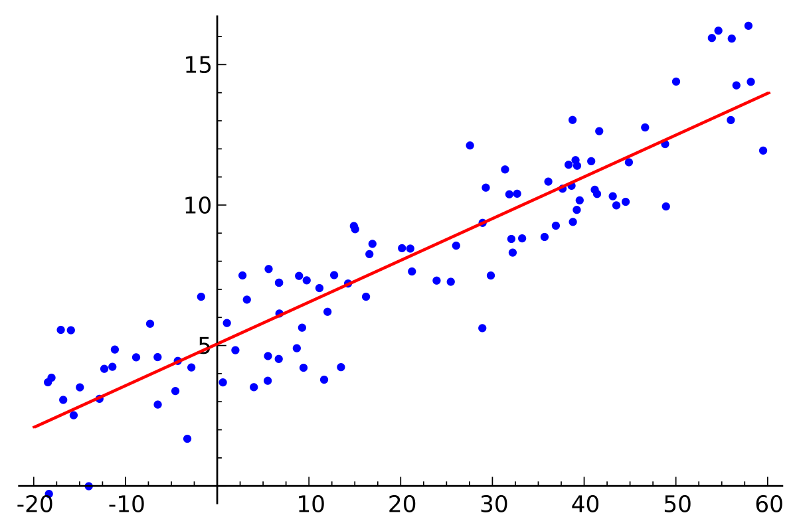
Regression
Supervised Learning
Training dataset
Predicted variable: continuous !
Stock markets, retirement plans, etc.

Slide 8
Regression: Spark ML components
LinearRegression
GeneralizedLinearRegression
IsotonicRegression
DecisionTreeRegressor
GBTRegressor
RandomForestRegressor
AFTSurvivalRegressor

Slide 9
Regression: Exercise 1
Input: A DataFrame of MPG (Miles Per Galon = distance travelled per galon of fuel) data, with the „features” (Vector) field as features and „mpg” field as label
Task: Fit a LinearRegression instance on trainingData and use it to predict MPG for verificationData and put it in the „mpg_predicted” field.
Verfication: RegressionTest, implemented in ScalaTest

Slide 10
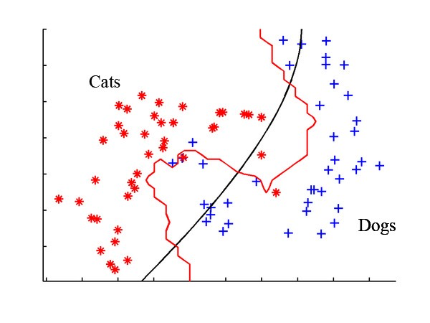
Classification
Predicted value: discrete!
Training dataset
Supervised Learning
Examples: Medical diagnoses, facial recognition, speech recognition

Slide 11
Classification: Spark ML components
DecisionTreeClassifier
RandomForestClassifier
GBTClassifier
LogisticRegression
MultilayerPerceptronClassifier
OneVsRest
NaiveBayes

Slide 12
Classification: Exercise 2
Input: A DataFrame with Iris (classification of subspieces of Irises) data, containing the „features” (Vector) field as features and „type_numeric” field as labels
Task: Fit a DecisionTreeClassifier on trainingData and then transform verificationData to predict type and put it in the „type_predicted” field
Verification: ClassificationTest

Slide 13
Filtering & Clustering
Two other popular ML techniques used in Spark ML
Filtering: unsupervised learning, predicting user preferences by using some related input (users with similar tastes, content)
Clustering: unsupervised, using metrics to subdivide the data into multiple clusters exhibiting similarities
Will not be expanded upon in this presentation

Slide 14
Utilities
Data is never in the correct form right away
Many utils to process DataFrames before they go into the ML component
Tokenization of strings, bucketing, indexing enums, assembling vectors, SQL transformations etc.
Implemented as Estimators / Transformers

Slide 15
Utilities: StringIndexer
Indexes String values to Double
Estimator: Learns possible values from training data => StringIndexerModel
Assigns values from 0.0 to N from most to least frequent
Parameters:
inputCol
outputCol
Inverse component: IndexToString

Slide 16
Utilities: VectorAssembler
Assembles a Vector column from multiple columns (all numeric / Vector/ Boolean)
Transformer
Parameters:
inputCols = columns used to assemble the Vector
outputCol
Most used Spark ML transformer ever!

Slide 17
Utilities: Binarizer
Double => 0.0 or 1.0
Threshold – based
Transformer
Parameters:
inputCol (String)
outputCol (String)
threshold (Double)

Slide 18
Utilities: Bucketizer
Puts Doubles into prescribed „buckets” => quantization
Transformer
Parameters:
inputCol
outputCol
splits = border points of buckets as Array[Double]

Slide 19
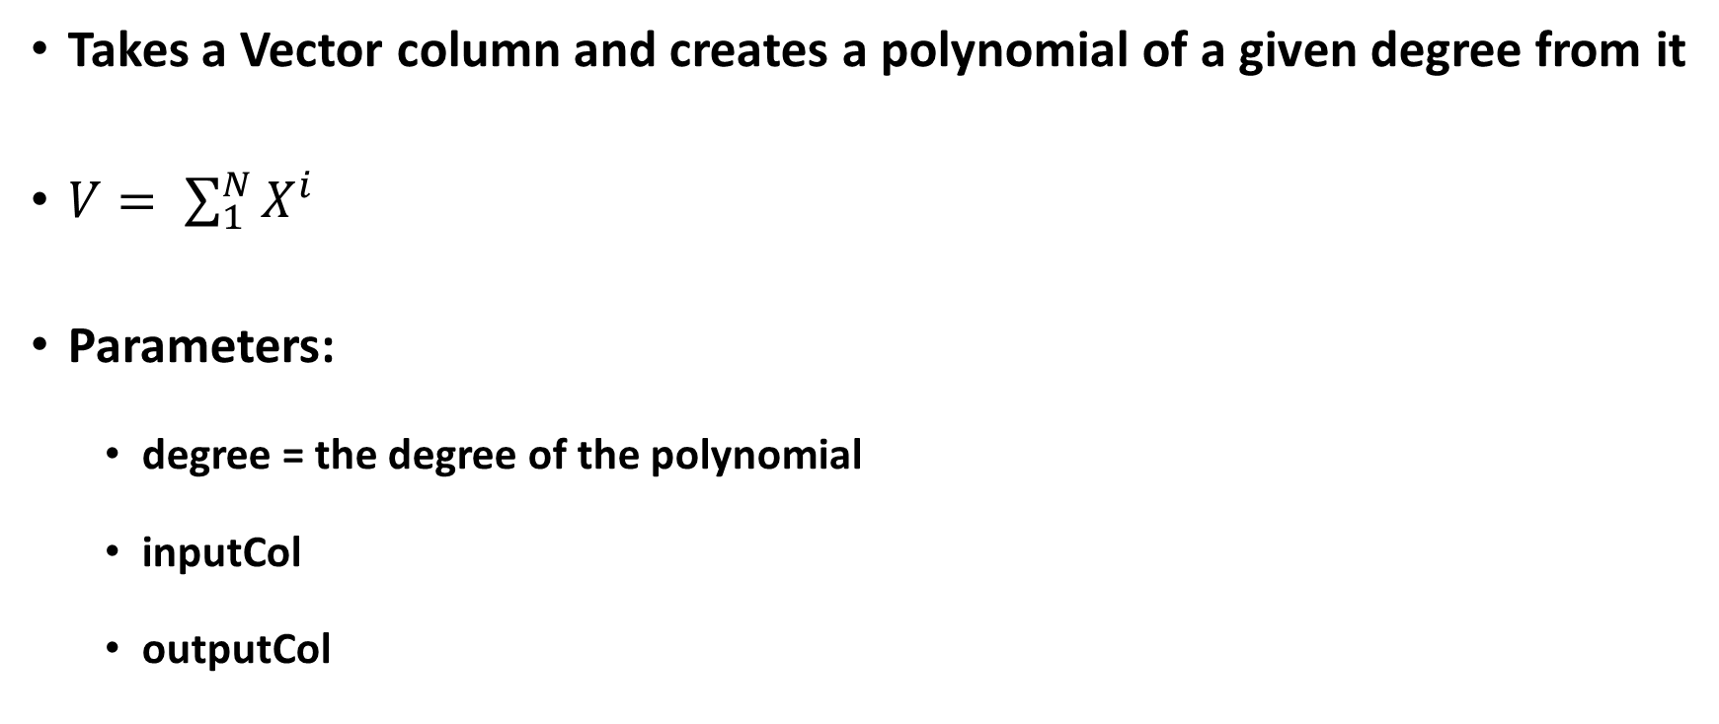
Utilities: PolynomialExpansion
Takes a Vector column and creates a polynomial of a given degree from it
$V= \sum_{1}^{N}{X^{i}}$
Parameters:
degree = the degree of the polynomial
inputCol
outputCol

Slide 20
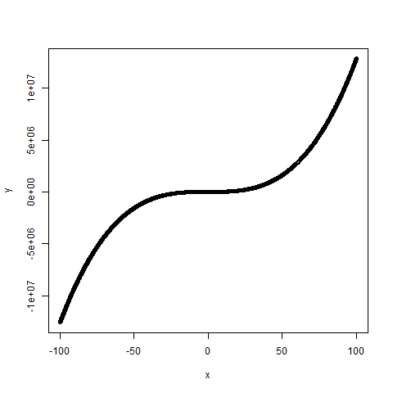
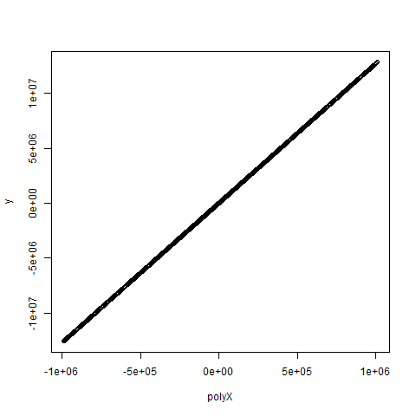
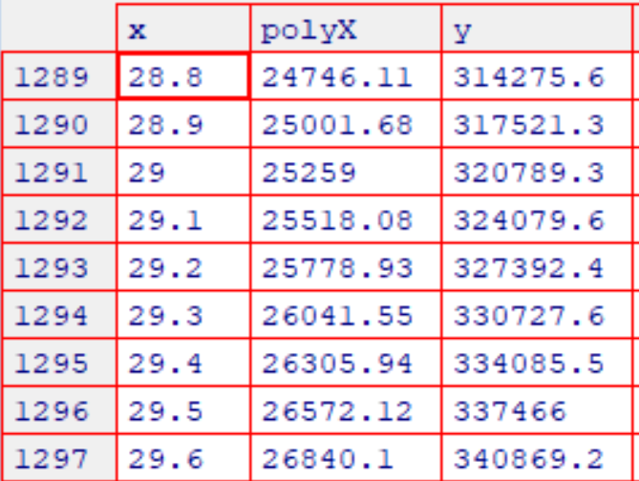
Utilities: Data Transformations + LinearRegression
We can use linear regression for some non-linear relationships, if we can easily figure what type of function represents the relationship well

Slide 21
Utilities: Exercise 3
Input: A Dataset[Patient] with the following records:
Implement the PatientPreprocessor, so that transforms these records into PatientPreprocessed instance, where „features” Vector is defined as:
features(0) = height
features(1) = weight
features(2) = if(sex == „Male”) 0.0; if(sex == „Female”) 1.0
features(3) = age, bucketized onto: {[0, 10], [10, 20], [20, 40], [40, 70], [70, 100]}
features(4) = if(otherIndicators <= 0.75) 0.0 else 1.0
Verification: Passing UtilsTest
case class Patient(sex: String, age: Double, height: Double, weigth: Double,
occupation: String, otherIndicators: Double, isIll: Boolean)

Slide 22
Pipelines
Pipeline = sequence of many Transformers and Estimators, processing the DataFrame one by one
Pipeline is an Estimator too (fit generates PipelineModel)
Easy way of composing multiple components to get an advanced functionality

Slide 23
Pipelines: Example
val tokenizer = new Tokenizer()
.setInputCol("text")
.setOutputCol("words")
val hashingTF = new HashingTF()
.setNumFeatures(1000)
.setInputCol(tokenizer.getOutputCol)
.setOutputCol("features")
val lr = new LogisticRegression()
.setMaxIter(10)
.setRegParam(0.001)
val pipeline = new Pipeline().setStages(Array(tokenizer, hashingTF, lr))

Slide 24
Pipelines: Exercise 4
Input: A DataFrame, with Patient rows inside + addtional „illness_actual” field: 1.0 if the patient is ill, 0.0 if he is not, split into training data and verification data
Task: In IllnessPredictorPipeline, implement „apply” to return a Pipeline creating a „features” (Vector) field, defined as:
features(0) = „Sex” field, indexed
features(1) = weight
features(2) = height
features(3) = otherIndicators + otherIndicators^2 + otherIndicators^3
features(4) = age + age^2 + age^3 and passes it through DecisionTreeClassifier, with prediction column „illness_predicted”
Verification: PipelineTest

Slide 25
Model Persistence
Once we have a trained model, we can call : model.write.save(path) to store it in a file
Reading model: LinearRegressionModel.read.load(path)
File format: JSON
{
"class":"org.apache.spark.ml.regression.LinearRegressionModel",
"timestamp":1522832562466,
"sparkVersion":"2.2.1",
"uid":"linReg_ab2242a8eb96",
"paramMap":{
"regParam":0.0,
"elasticNetParam":0.0,
"predictionCol":"prediction",
"featuresCol":"x",
"aggregationDepth":2,
"solver":"auto",
"maxIter":100,
"tol":1.0E-6,
"fitIntercept":true,
"labelCol":"y",
"standardization":true
}
}

Slide 26
Model Persistence: Usages
If your Data Scientist works in R / Python, we can still export the model for you to use in Spark ML
We can archive old models for future verification / auditing
Sharing models between running applications

Slide 27
Model Persistence: Exercise 6
Input: Trained LinearRegressionModel instance
Task: Implement „saveModel” and „readLinearRegressionModel” to write (with overwrite) the model to a file and read back the same model using Spark ML model persistence
Verification: ModelIOTest

Slide 28
CrossValidator: How to choose component parameters?
Many components have params that are not learned, but set.
„K” for KMeans, number of trees in tree-based classifiers and regressors etc.
The entire pipeline can have many such „a priori” parameters

Slide 29
CrossValidator: how and why?
Historical data split into folds
Use all folds except one to train with a combination of parameters, then use the last one for verification (Spark ML Evaluator)
Repeat for all combination of parameters a choose the best one

Slide 30
CrossValidator: how and why?
val tokenizer = new Tokenizer() .setInputCol("text") .setOutputCol("words")
val hashingTF = new HashingTF() .setInputCol(tokenizer.getOutputCol) .setOutputCol("features")
val lr = new LogisticRegression() .setMaxIter(10)
val pipeline = new Pipeline() .setStages(Array(tokenizer, hashingTF, lr))
val paramGrid = new ParamGridBuilder()
.addGrid(hashingTF.numFeatures, Array(10, 100, 1000))
.addGrid(lr.regParam, Array(0.1, 0.01)) .build()
val cv = new CrossValidator()
.setEstimator(pipeline)
.setEvaluator(new BinaryClassificationEvaluator)
.setEstimatorParamMaps(paramGrid) .setNumFolds(2)
val cvModel = cv.fit(training)

Slide 31
CrossValidator: Exercise 5
Task: Implement a CrossValidator, with a Pipeline inside that takes a Dataset of IncomeData records and builds a „features” Vector defined as follows:
features(0) = indexed „sex” field
features(1) = indexed „educationLevel” field
features(2) = indexed „fieldOfExpertise” field
features(3) = age
features(4) = yearsOfExperience
and passes it through a RandomForestClassifier, whose „numTress” parameter CrossValidator will optimize. Use MutliclassClassificationEvaluator
Verification: CrossValidatorTest

Slide 32
Summary
Easy integration with other Spark modules: one of the best Big Data / cluster computing frameworks there is
Lot’s of out-of-the-box, easily configurable components
Composable pipelines & advanced components like cross-validation
Model persistence / exchange

